Slide 1
Battle of Neighborhoods
Two metros of India
DELHI and MUMBAI

Slide 2
Objective
Identifying and understanding the business opportunities in two metro cities in India to find locations for Speciality restaurants

Slide 3
Python packages and Dependencies:
Pandas - Library for Data Analysis
NumPy – Library to handle data in a vectorized manner
JSON – Library to handle JSON files
Geopy – To retrieve Location Data
Requests – Library to handle http requests
Matplotlib – Python Plotting Module
Sklearn – Python machine learning Library
Folium – Map rendering Library

Slide 4
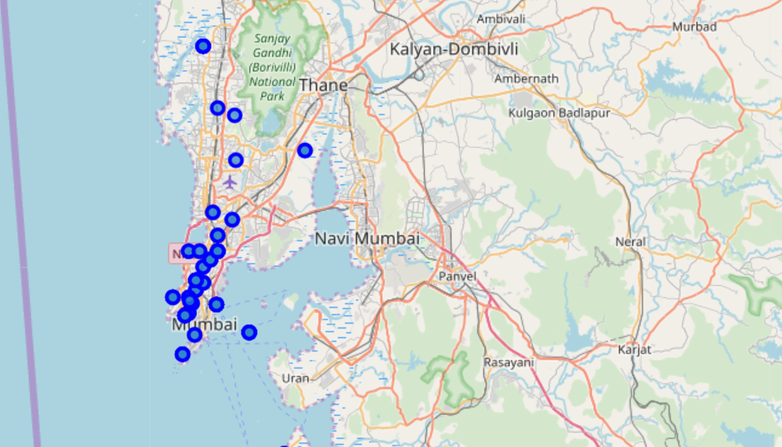
MUMBAI – folium map

Slide 5
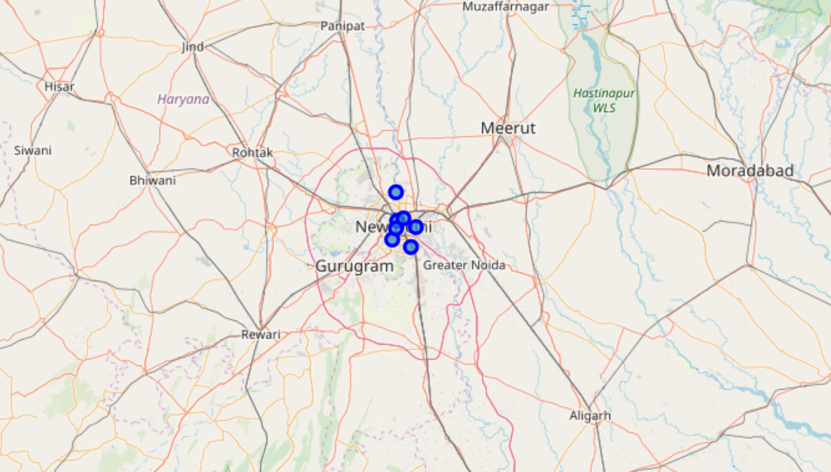
Folium map NEW DELHI

Slide 6
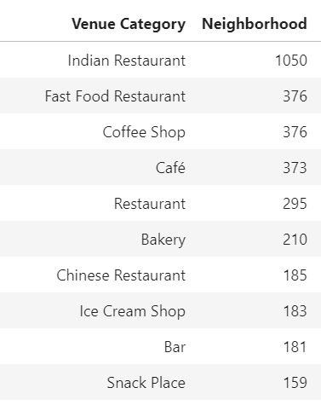
Most popular Businesses in Mumbai

Slide 7
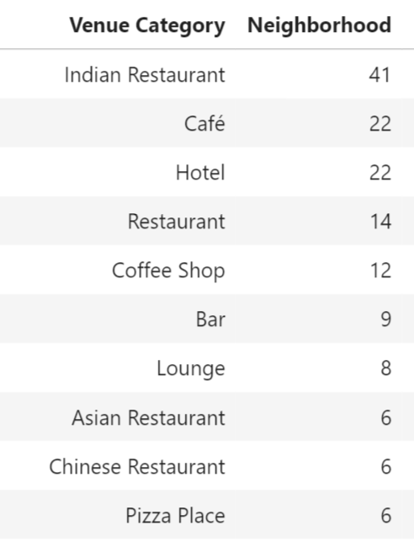
Most popular Businesses in New Delhi

Slide 8
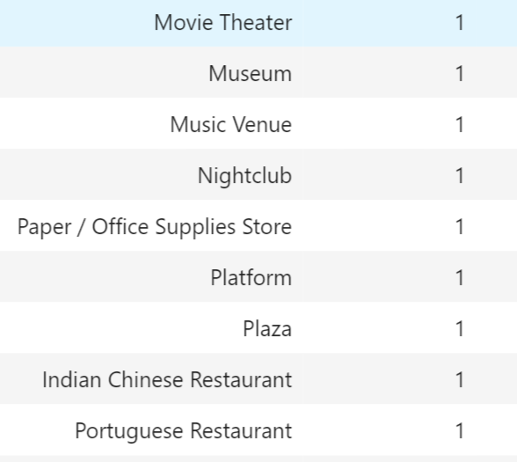
Venue categories with less outlets in Delhi

Slide 9
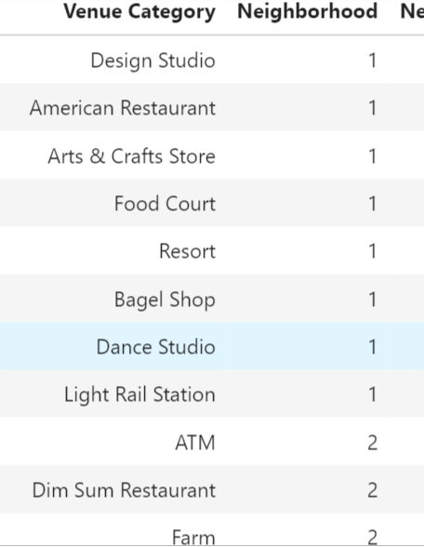
Venue Categories with less outlets in Mumbai

Slide 10
Categories of restaurant in less number and can be speciality for Mumbai-Delhi
1. Portugese restaurants
2. American restaurants
3. South American Restaurants
4. Korean Restaurants
5. Spanish Restaurants
6. Scandinavian
7. Modern European
8. Turkish

Slide 11
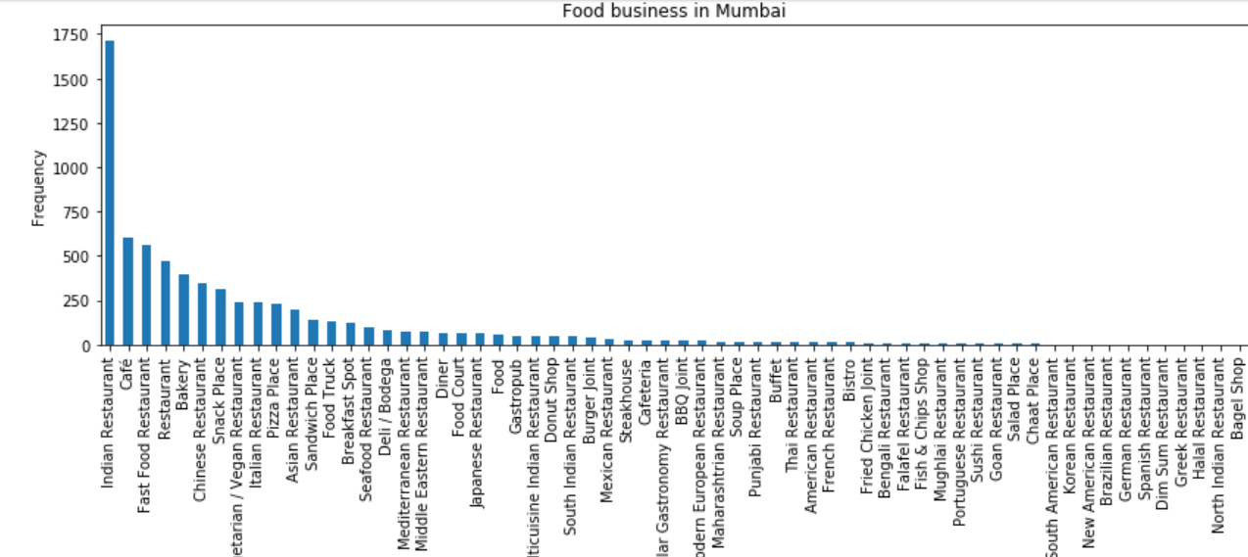
Restaurant categories- Mumbai

Slide 12
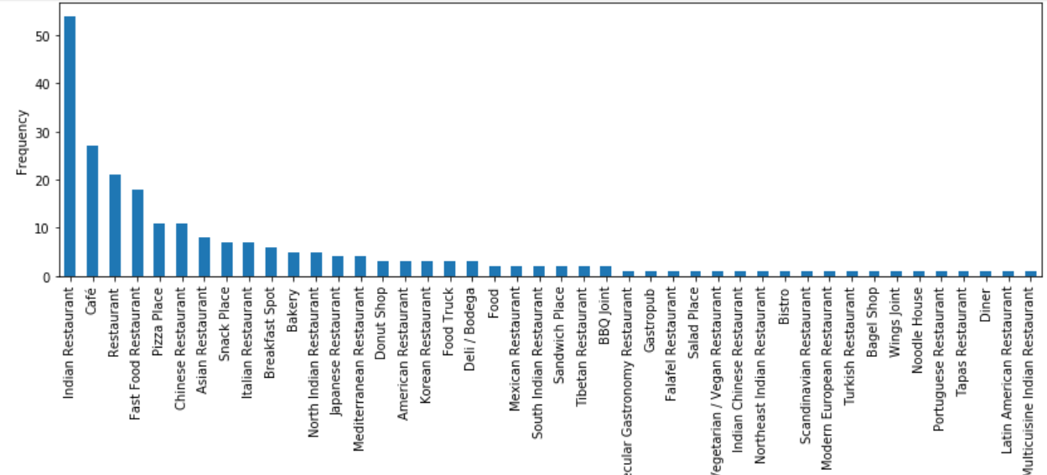
Restaurant categories – New delhi

Slide 13
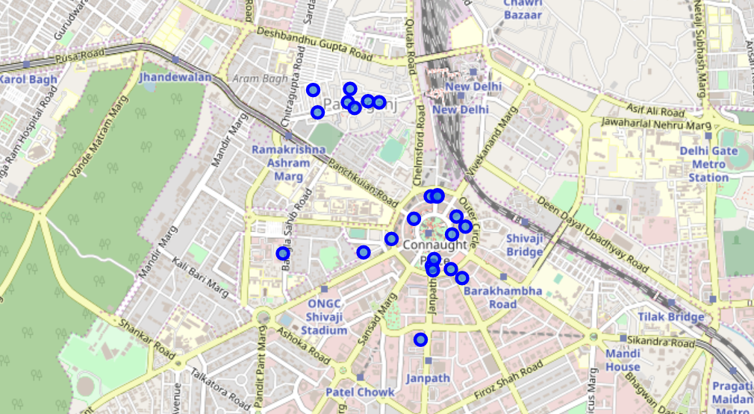
speciality restaurants in New Delhi

Slide 14
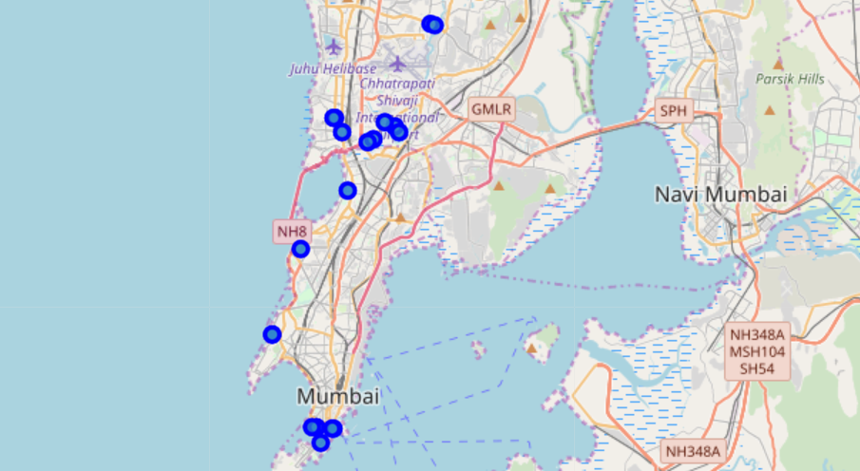
Speciality Restaurents Mumbai

Slide 15
Categories of restaurant in less number and can be speciality for business
1. Portugese restaurants
2. American restaurants
3. South American Restaurants
4. Korean Restaurants
5. Spanish Restaurants

Slide 16
RECOmmendation
The existing speciality restaurants are concentrated in Nariman point, beach area and Bandra area.
In New Delhi, the speciality restaurants are mainly in Paharganj and Cannaught Place areas.
It is recommended that the new speciality restaurant is opened in the same area. List of such restaurants is in previous slide.

Slide 17
Thank you

